Slide 2
KdmA complex members
Factor | Description | Peak shape | Yeast ortholog | Color
kdmA (AN1060) | Histone H3 demethylase, involved in transcriptional regulation | Broad peaks | RPH1 | #DA0000; kdmA_short: #ff3363
cclA (AN9399) | Protein involved in histone H3 lysine 4 methylation; plays a role in secondary metabolite cluster gene expression; null mutants display increased secondary metabolite cluster gene expression | Broad peaks | BRE2 | #3300D4; kdmA_del: #240099
mcmA (AN8676) | Putative MADS-box family transcription factor; ORF that was absent from the original release of version 4 of the A. nidulans annotation, but present in a previous version; reinstated into version 4 in AspGD as of July 2009 | Narrow peaks | MCM1 | #008159; kdmA_del: #004d34
ecmB (AN5533) | Pol-II TF activity; sterol regulatory factor | Narrow peaks | ECM22 | #990084; kdmA_del: #660058
rstB (AN12489) | RNA pol II factor, A zinc finger protein that regulates a Transcription factor for sexual devlopment in S.pombe. | Narrow peaks | YGR067C | #A65628; kdmA_del: #7b401e

Slide 3
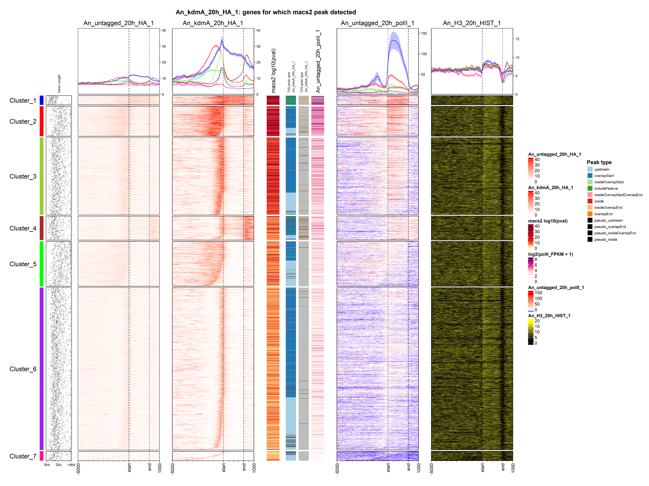

Slide 4
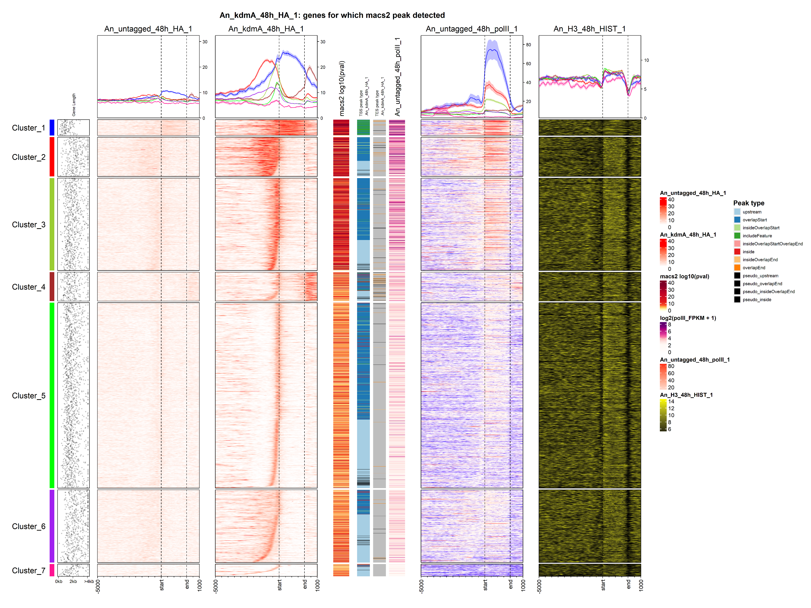

Slide 5
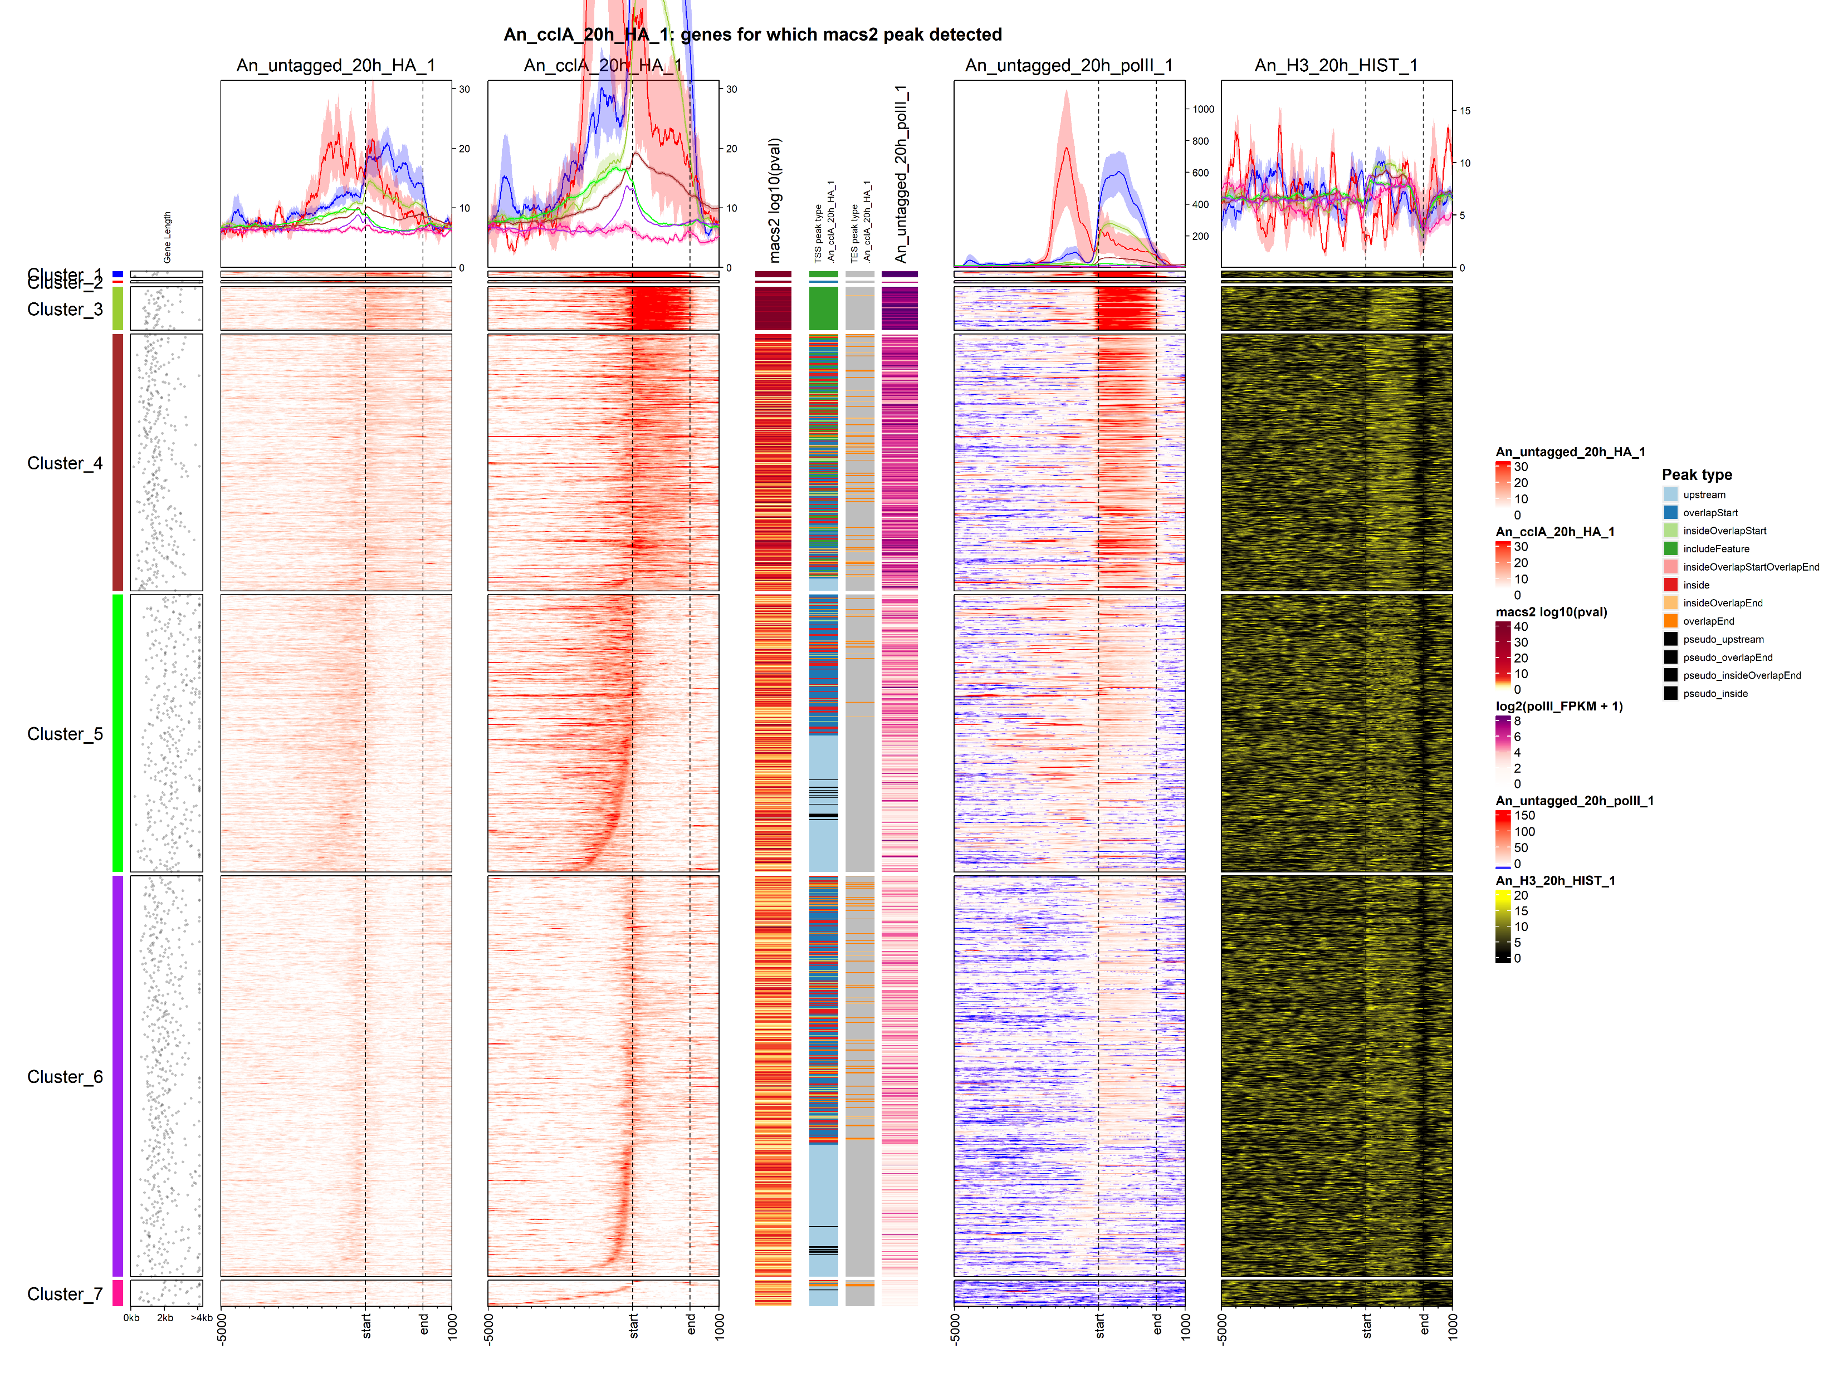
Good association of cclA with polII at 20h

Slide 6
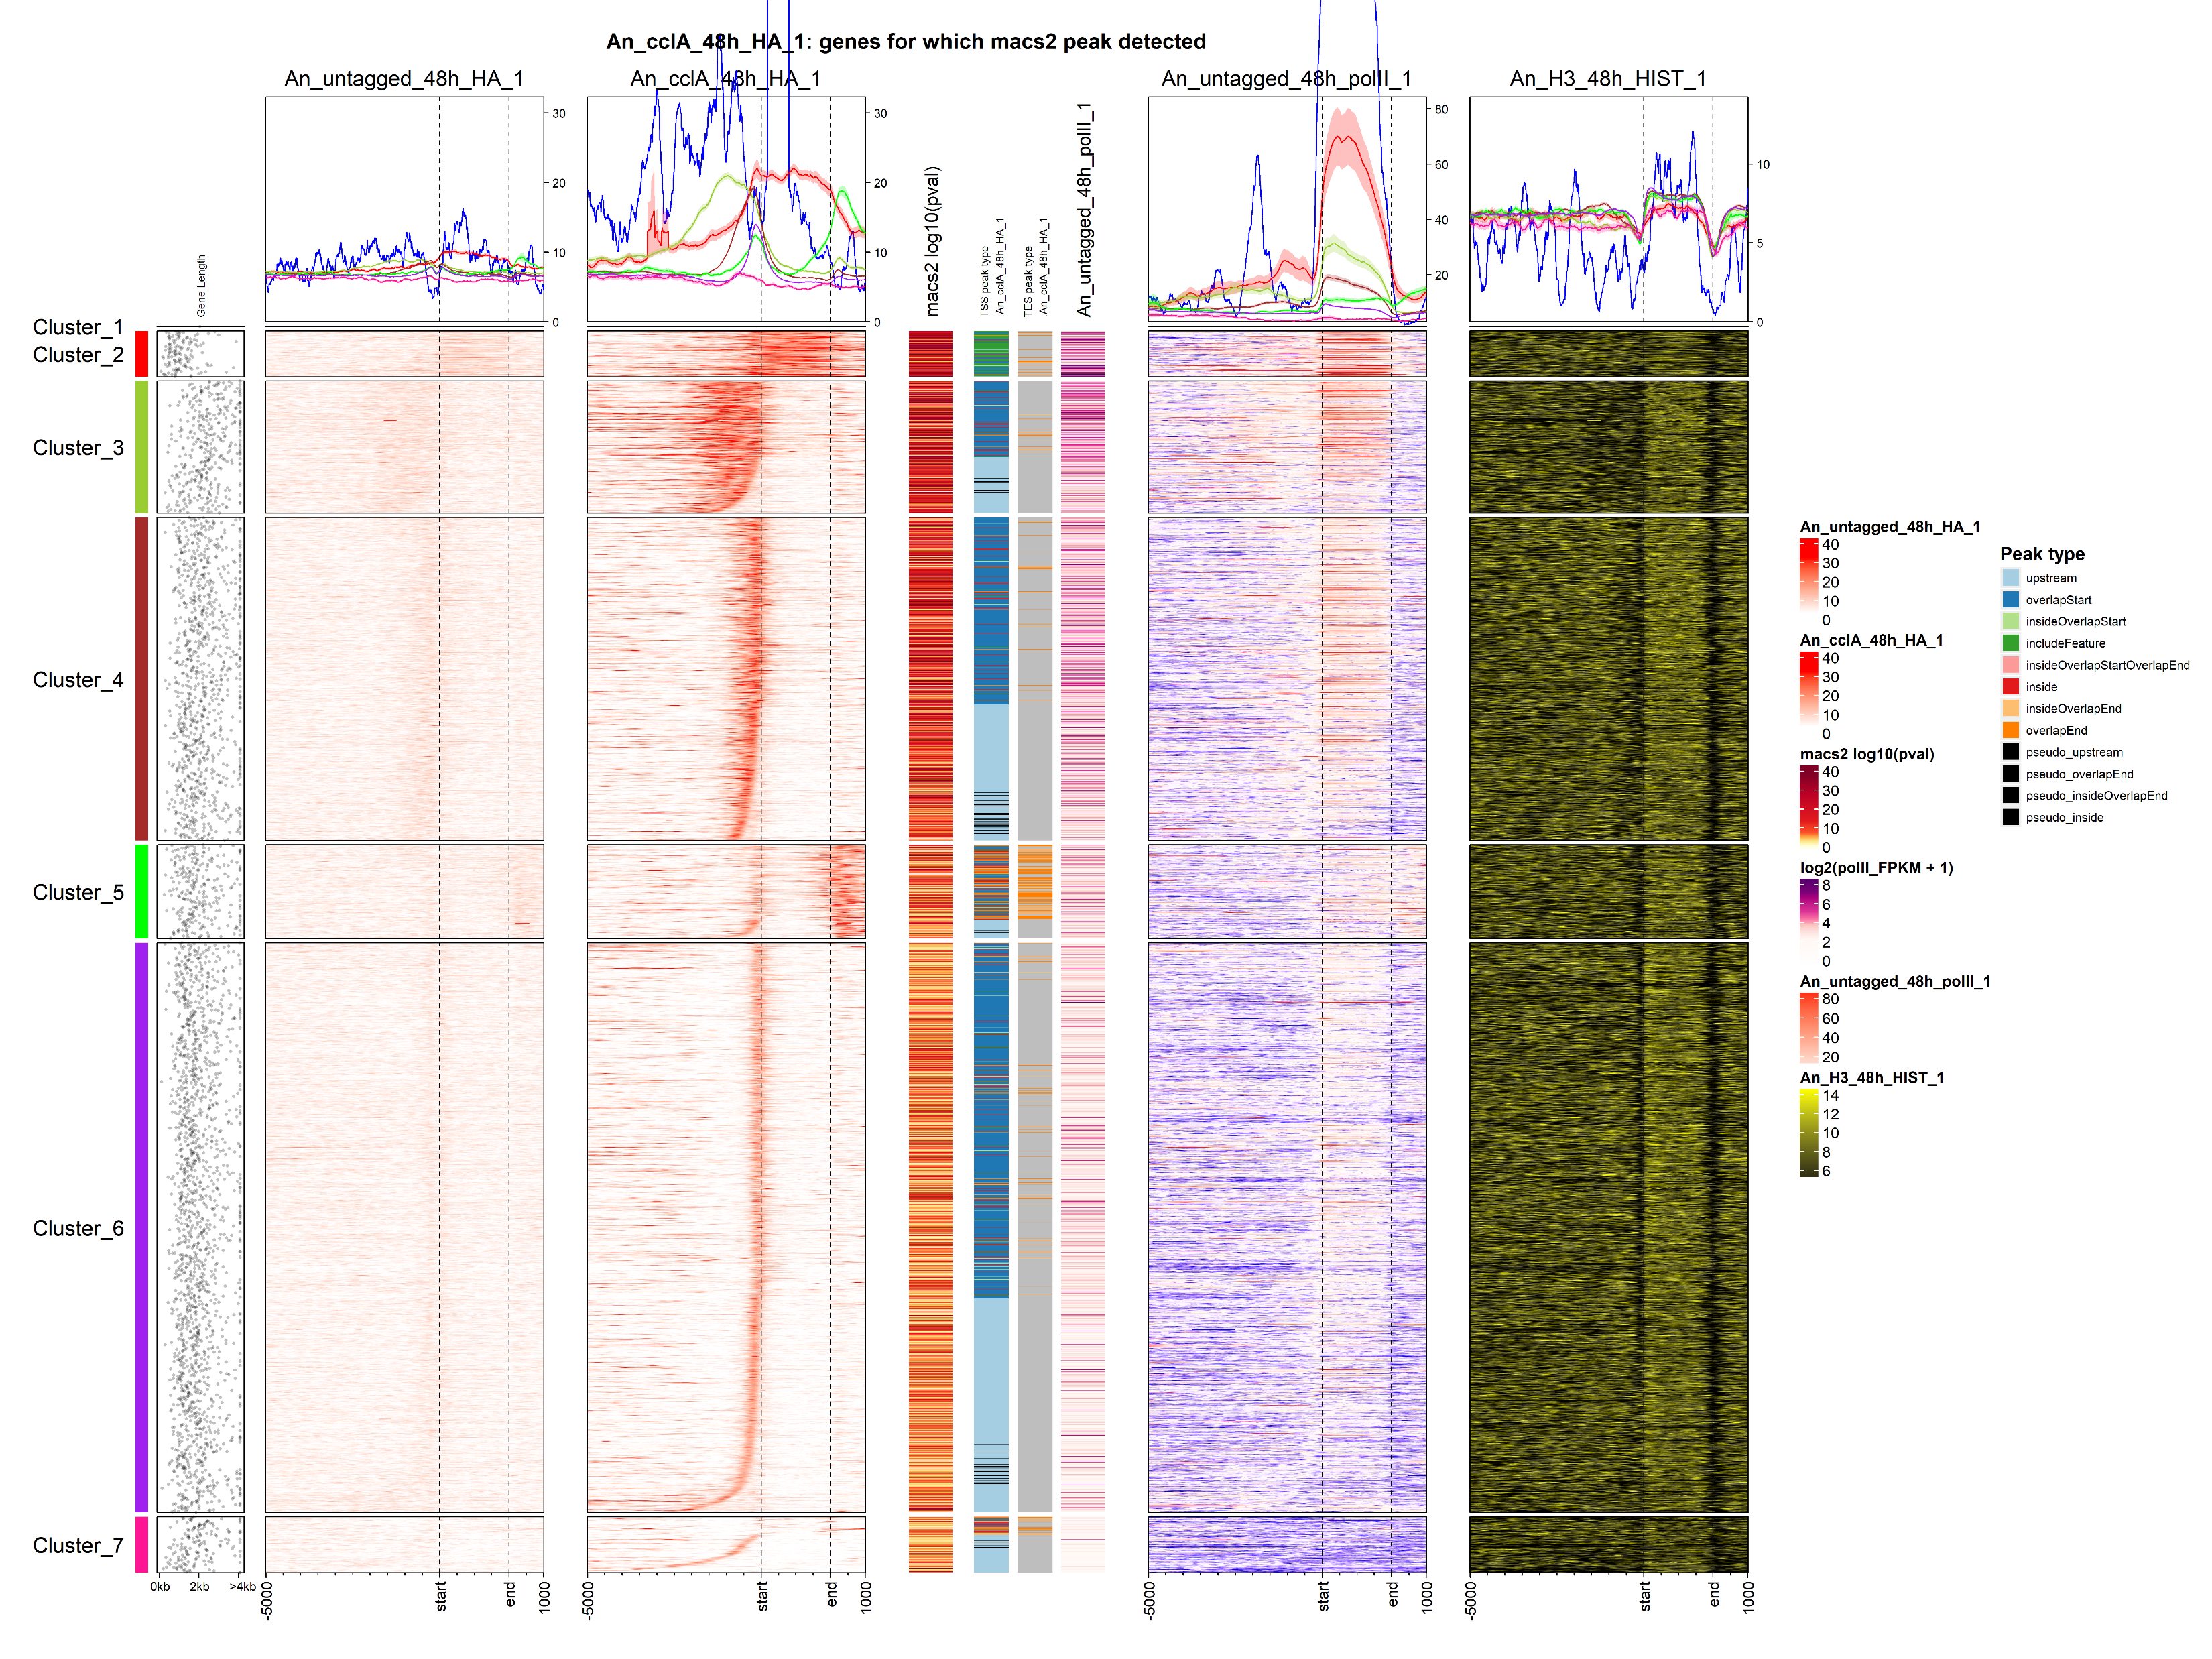
At 48h, cclA travels less with polII.

Slide 7
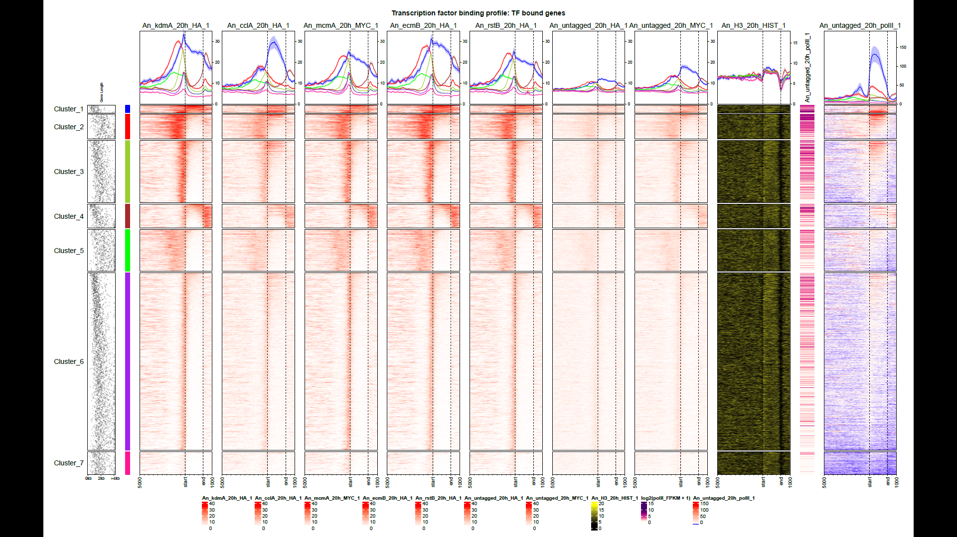

Slide 8
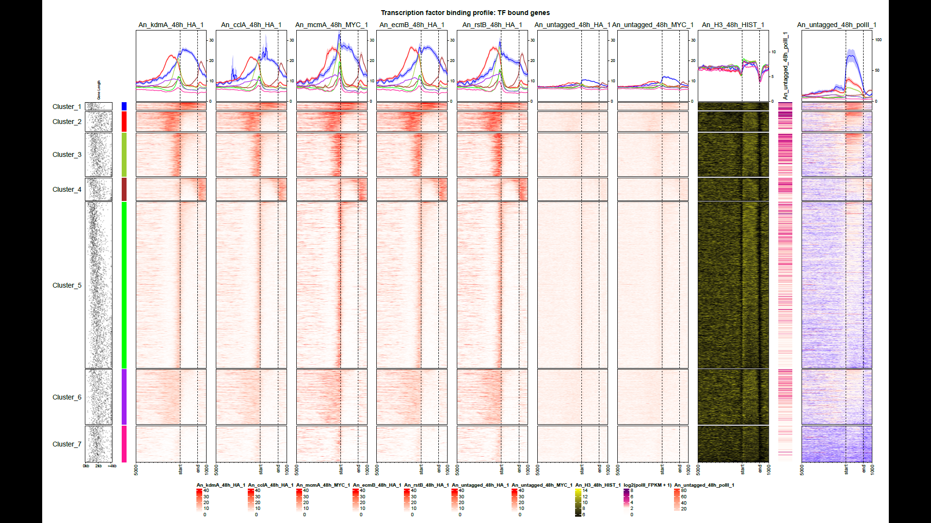

Slide 9
Various SM levels determined by chromatography in kdmA complex mutant strains
Data shared by Mevlut was used for generating this plot
Each row correspond to a secondary metabolite level in different strains (columns)
For each metabolite, the SM level was scaled between row-min to row-max range.

